Slide 1

Predicting Employee Attrition Using Random Forest With IBM Cloud
Prepared By :
Jaswanth
Manasa
Sai Sruthi
Salman
Kavya

Slide 2
Every year a lot of companies hire a number of employees. The companies invest time and money in training those employees, not just this but there are training programs within the companies for their existing employees as well. The concept of these programs is to increase the effectiveness of their employees. If there is any model that can predict employee attrition it will be easy to analyze the attrition process and improving the performance of employees. The intension is to build a model that predicts the Attrition of the Employees based on the given factors of an employee using Machine Learning.

Slide 3
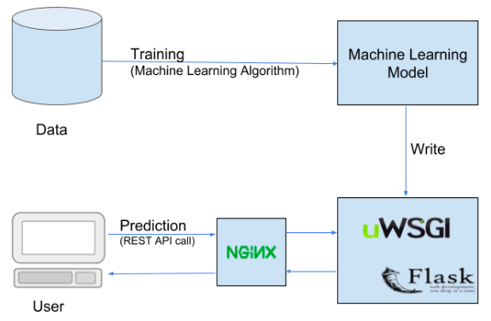
SPYDER FLASK html ..codes
BLOCK DIAGRAM

Slide 4
STEPS THAT INCLUDE EMPLOYEE PREDICTION
Installing Python IDE. Here the priority is Anaconda.
Importing the required libraries for the model to run.
Downloading the dataset and feeding it to the model.
Data pre-processing – if there any null values.
Converting the strings into the binary format by using Label Encoding and One Hot Encoding.
Dividing the model into Train and Test data.
Fitting the model (train dataset).
Predicting the Case Status.

Slide 5
INSTALLING REQUIRED IDE(integrated development environment ) with python packages
First we need to install Anaconda/ PyCharm IDE is Ideal to complete this project
We need to install the following packages:
1.Numpy: This package is used to perform numerical computations. This package is pre-installed in anaconda.
2.Pandas: Pandas is one of the most widely used python libraries in data science. It provides high-performance, easy to use structures, and data analysis tools. This package is pre-installed in anaconda.
3.Matplotlib: Matplotlib is a comprehensive library for creating static, animated, and interactive visualizations in Python. This package is pre-installed in anaconda.
4.Scikit-learn: This is a machine learning library for the Python programming language. This package is pre-installed in anaconda.
5.Flask: Flask is a lightweight WSGI web application framework.

Slide 6
Data Collection and Preprocesing
ML depends heavily on data, without data, it is impossible for an “AI” to learn. It is the most crucial aspect that makes algorithm training possible. In Machine Learning projects, we need a training data set. It is the actual data set used to train the model for performing various actions.
Data pre-processing is a process of cleaning the raw data i.e. the data is collected in the real world and is converted to a clean data set. In other words, whenever the data is gathered from different sources it is collected in a raw format and this data isn’t feasible for the analysis.
Therefore, certain steps are executed to convert the data into a small clean data set, this part of the process is called as data pre-processing Follow the following steps to process your Data
Import the Libraries
Importing the dataset
Taking care of Missing Data
Label encoding
One Hot Encoding
Feature Scaling
Splitting Data into Train and Test

Slide 7
MODEL BUILDING
There are several Machine learning algorithms to be used depending on the data you are going to process such as images, sound, text, and numerical values. The algorithms that you can choose according to the objective that you might have it may be Classification algorithms are Regression algorithms. As the dataset which we are using is a Regression dataset so you can use the following algorithms
Linear Regression.
Logistic Regression.
Random Forest Regression / Classification.
Decision Tree Regression / Classification.
You will need to train the datasets to run smoothly and see an incremental improvement in the prediction rate.
Now we apply the decision tree regression algorithm on our dataset.

Slide 8
TRAINING AND SAVING THE MODEL
Once after splitting the data into train and test, the data should be fed to an algorithm to build a model.
The machine learning algorithms used for this model here is Linear Regression. The Random Forest Classifier is a set of decision trees from a randomly selected subset of the training set. It aggregates the votes from different decision trees to decide the final class of the test object.
After building the model we have to save the model
Pickle in Python is primarily used in serializing and deserializing a Python object structure. In other words, it's the process of converting a Python object into a byte stream to store it in a file/database, maintain program state across sessions or transport data over the network. wb indicates the write method and rd indicates the read method.

Slide 9
BUILDING FLASK APPLICATION
Flask Frame Work with Machine Learning Model In this section, we will be building a web application that is integrated into the model we built. A UI is provided for the uses where he has to enter the values for predictions. The enter values are given to the saved model and prediction is showcased on the UI.
To build this flask application you should have basic knowledge of “HTML, CSS, Bootstrap, flask framework and python

Slide 10
BUILDING FLASK WITH WEB PAGES
Let us build flask file ’PAE_Flask.ipynb’ which is a web framework written in python for server-side scripting. Let’s see step by step procedure for building the backend application.
You can also run this on spyder, given as app.py
App starts running when “__name__” constructor is called in main.
Render_template is used to return html file.
“GET” method is used to take input from the user.
“POST” method is used to display the output to the user.
A webpage is created as “loll.html” for predictin of employee

Slide 11
TRAINING OF MODEL IN IBM CLOUD
For training the model in IBM cloud you need to create an account in IBM
After Registration , Login into your IBM account
There includes two steps in training :
1. Train the Machine learning model to IBM
2. Integrate Flask with IBM with scoring end point

Slide 12
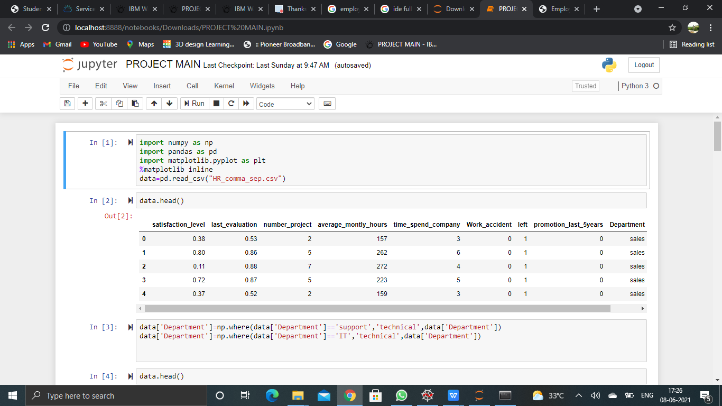

Slide 13
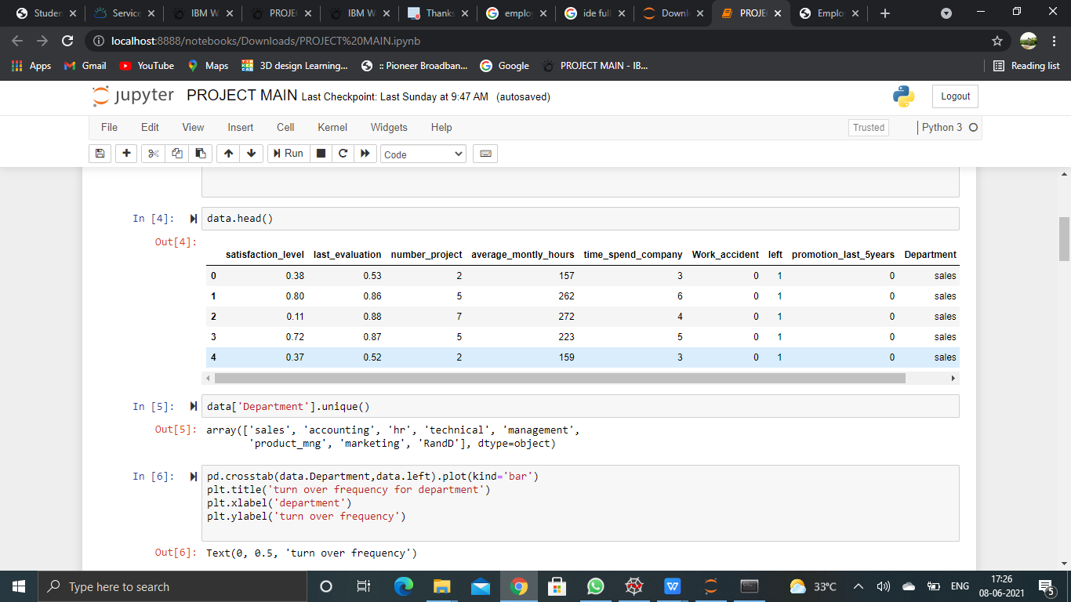

Slide 14
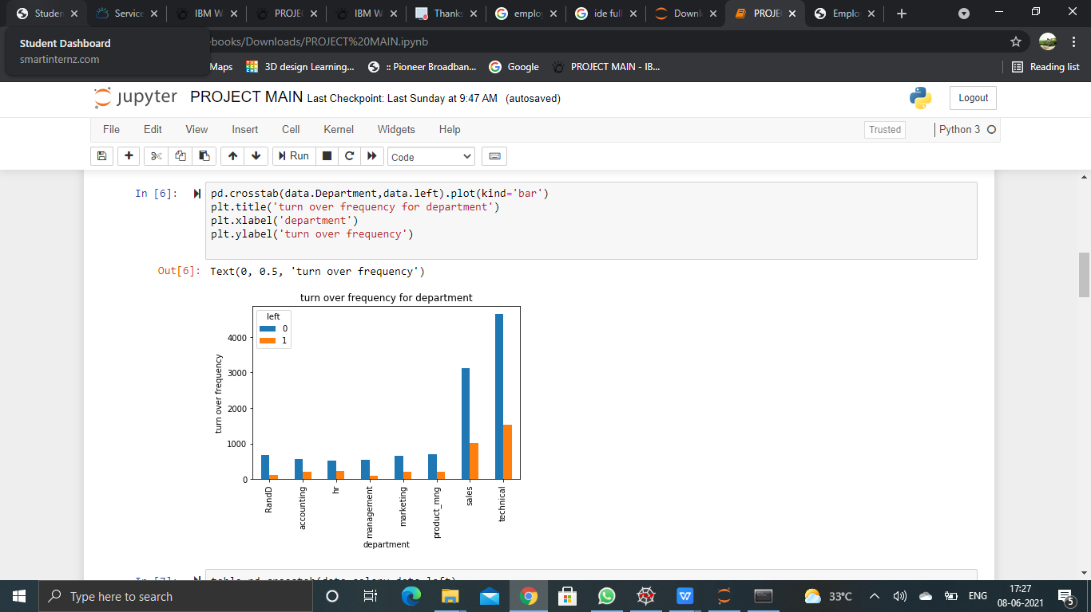
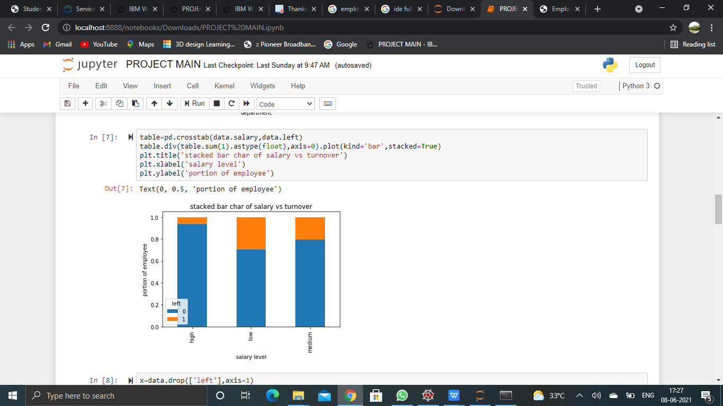

Slide 15
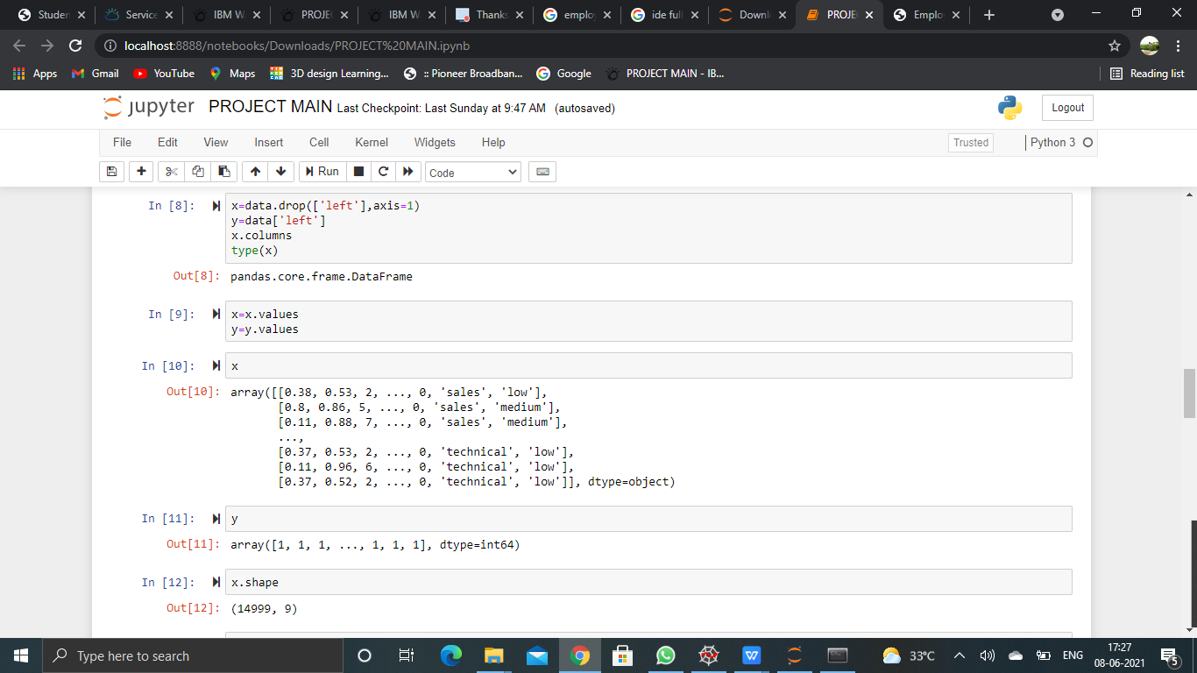
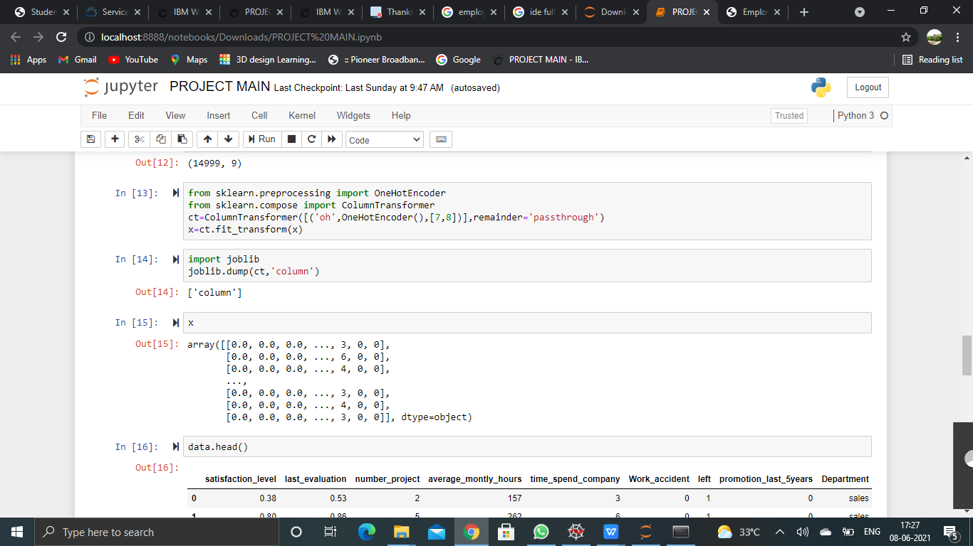

Slide 16
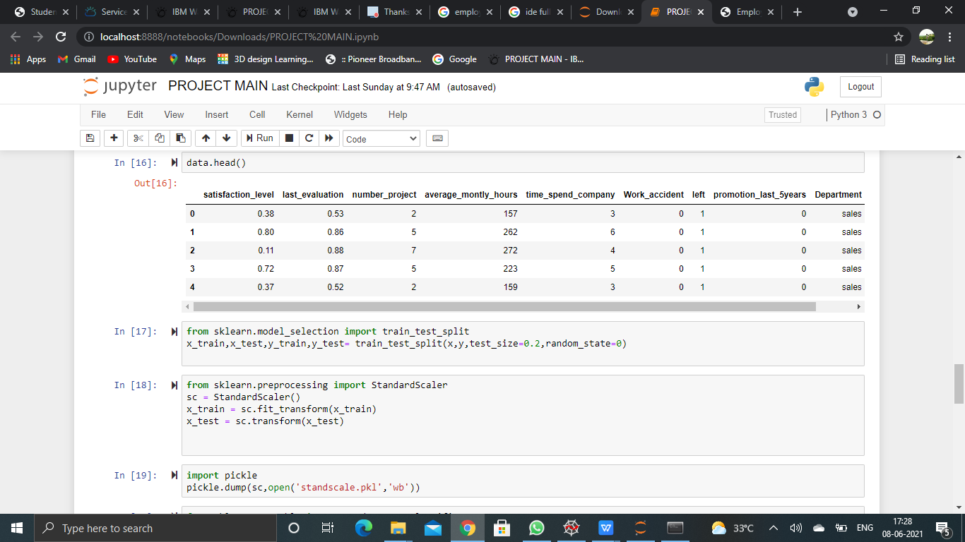
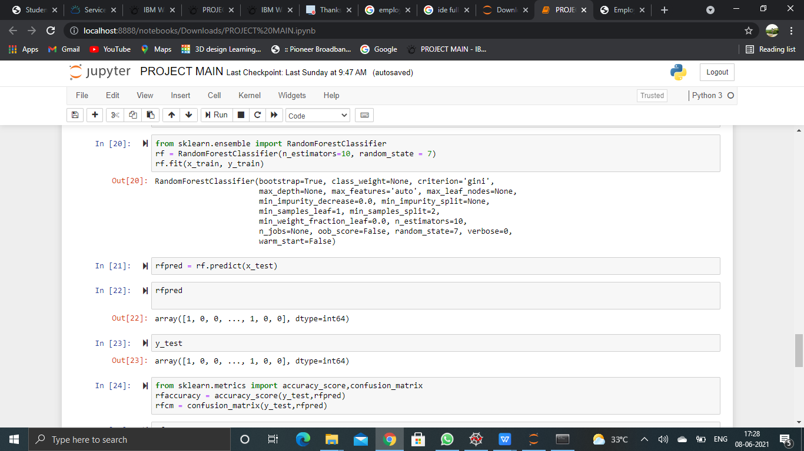

Slide 17
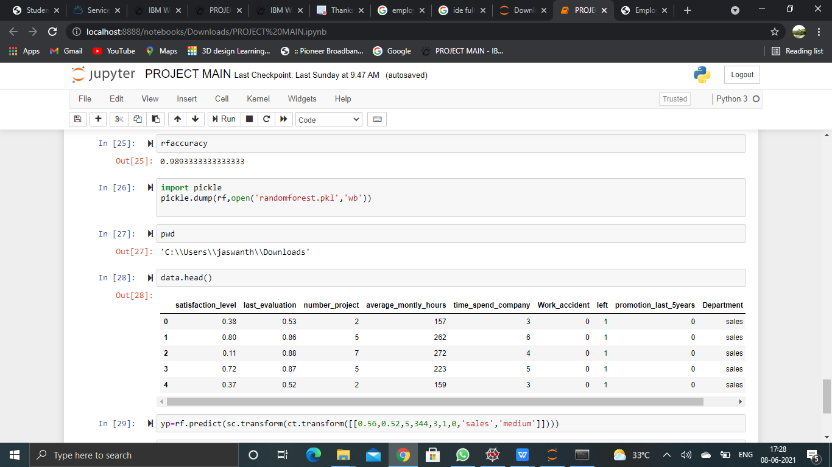
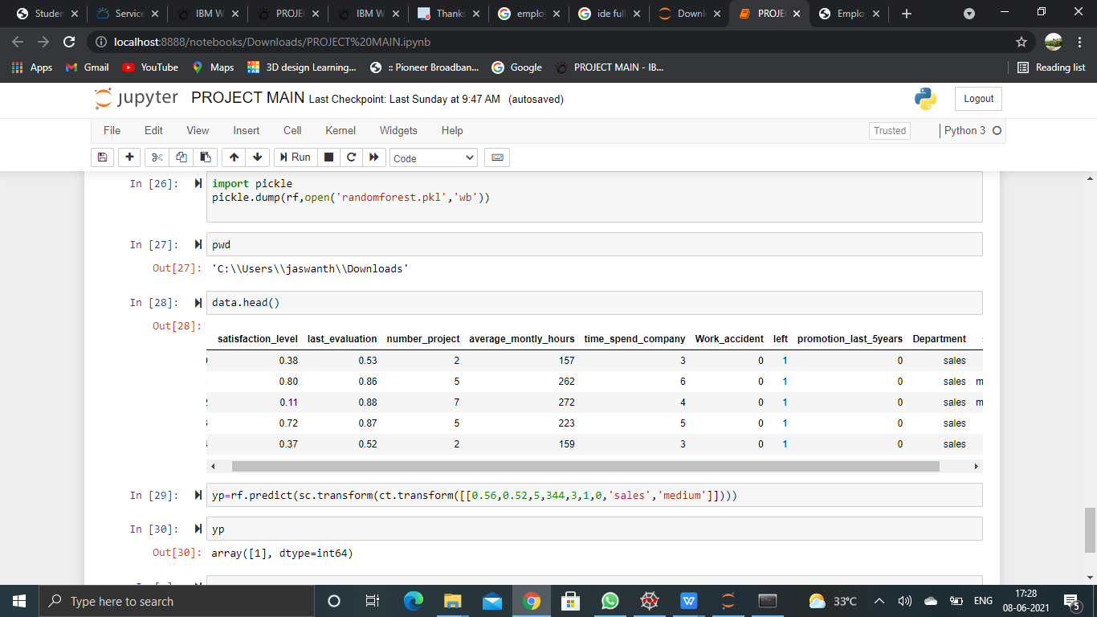

Slide 18
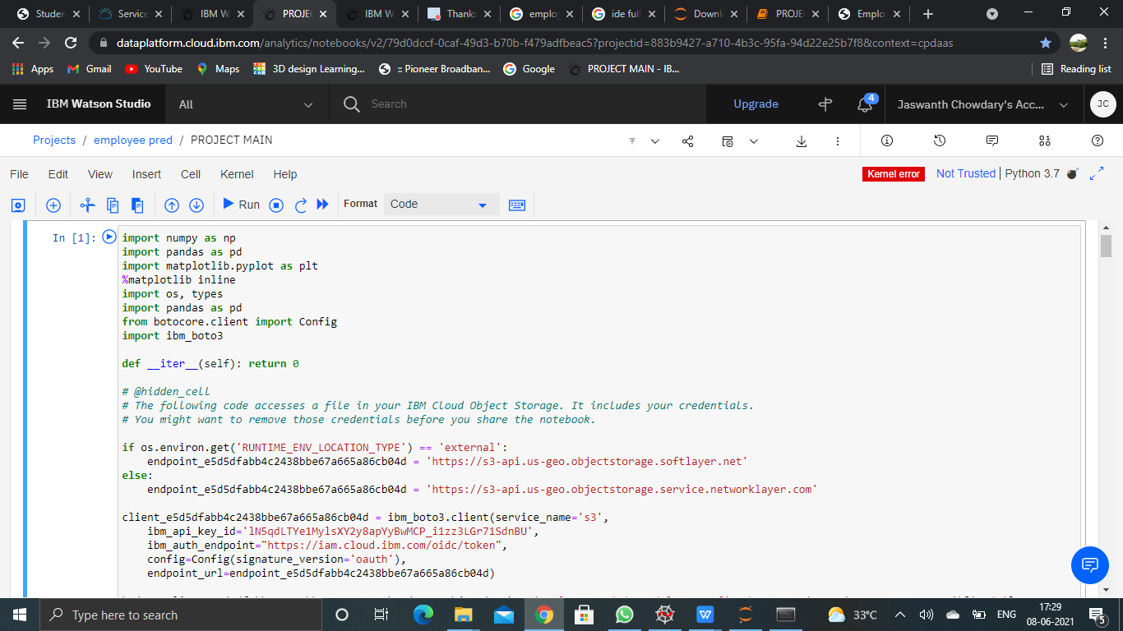

Slide 19
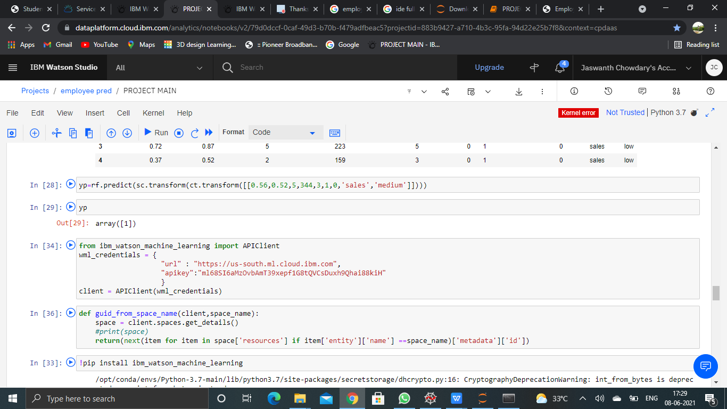
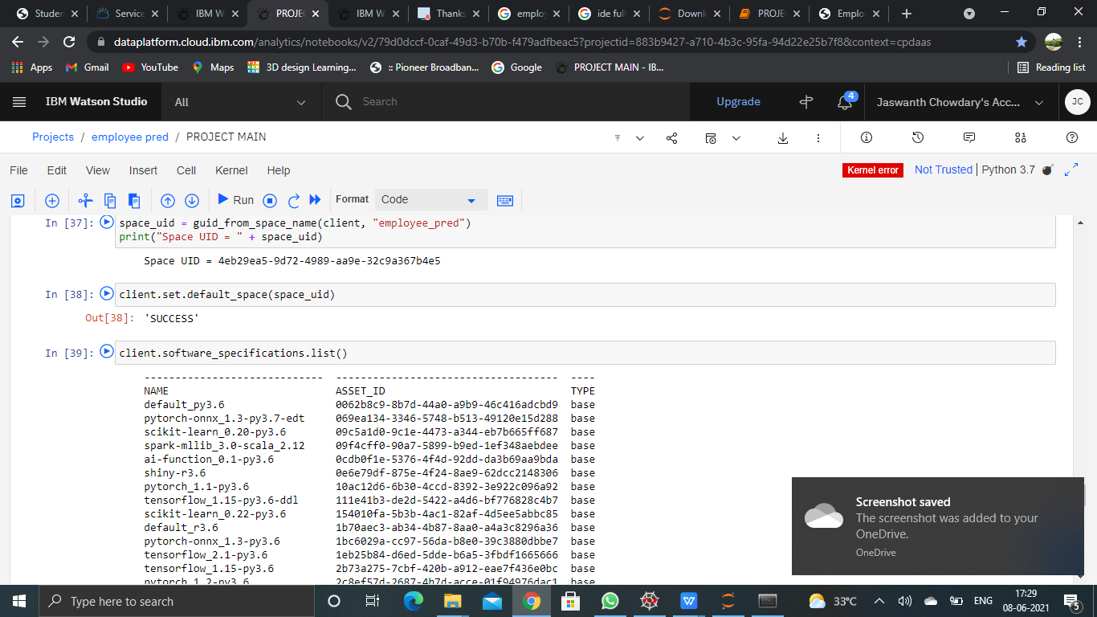

Slide 20
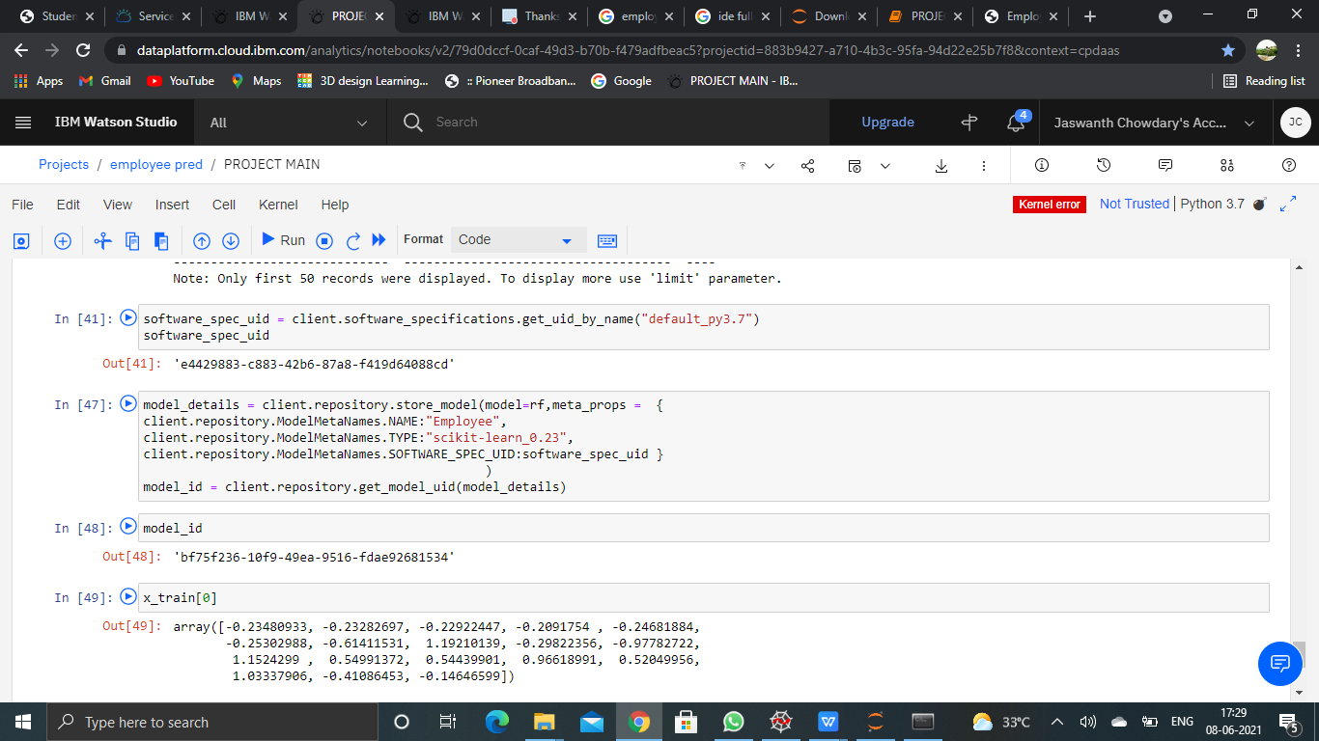
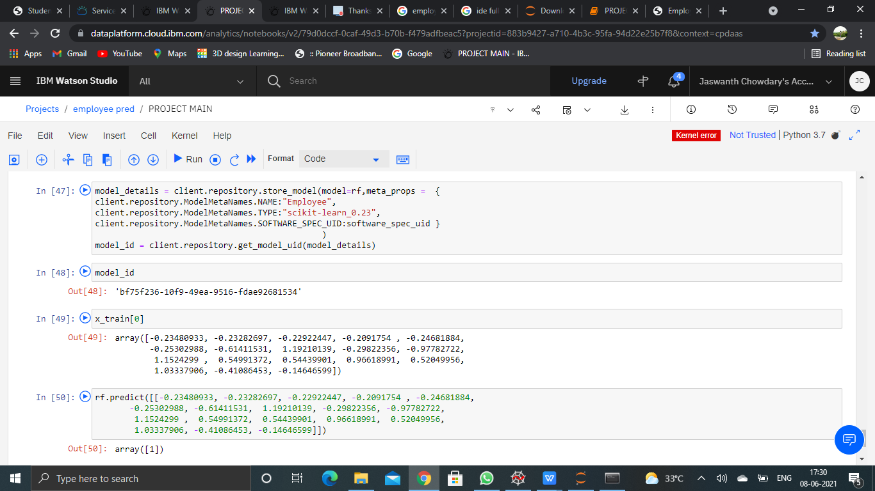

Slide 21
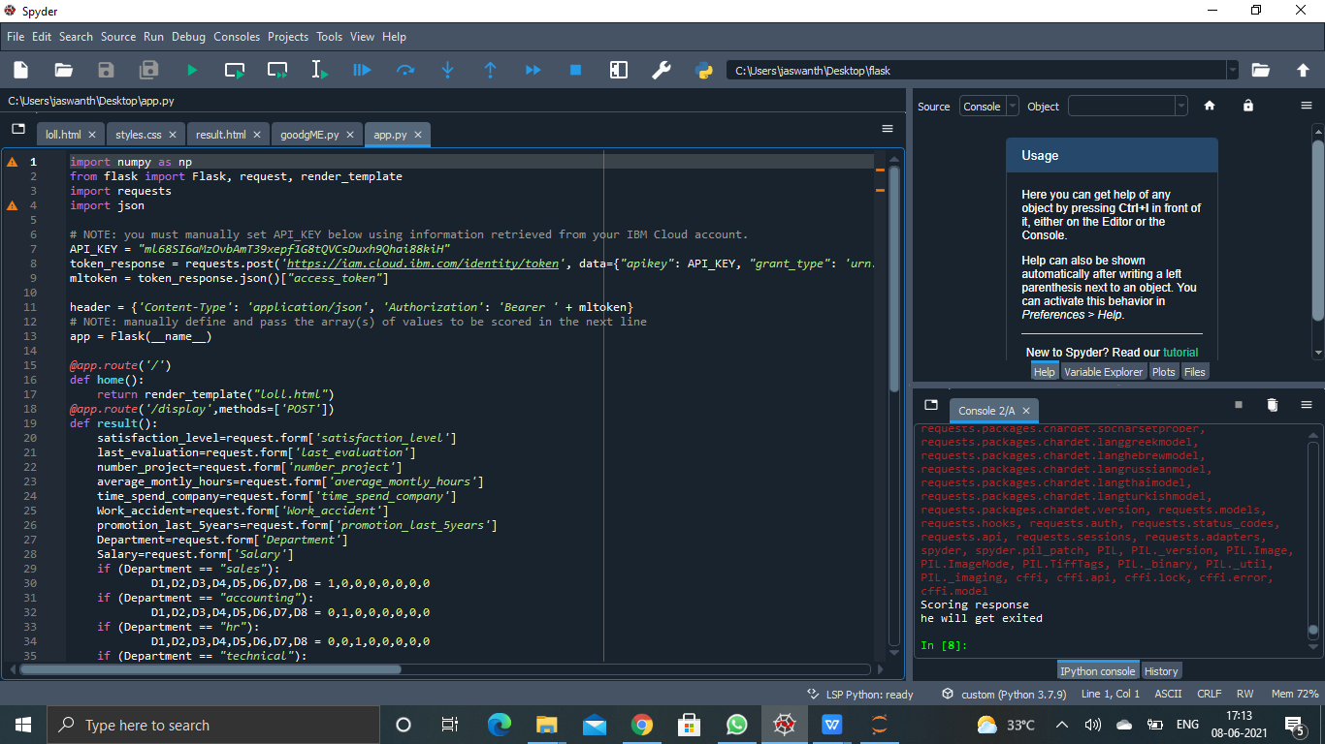
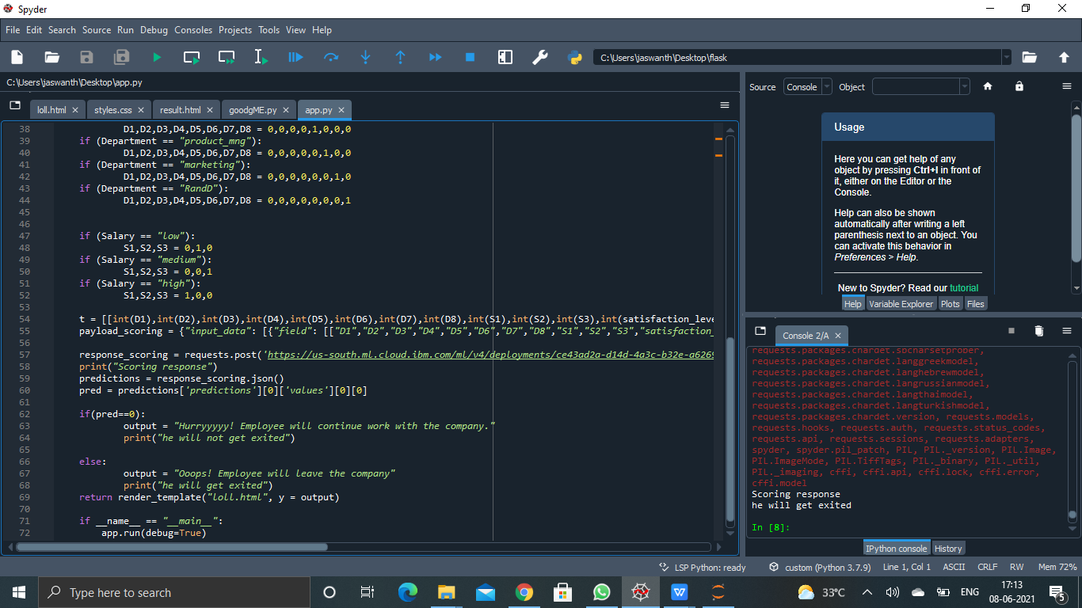
FLASK FILES USING SPYDER

Slide 22
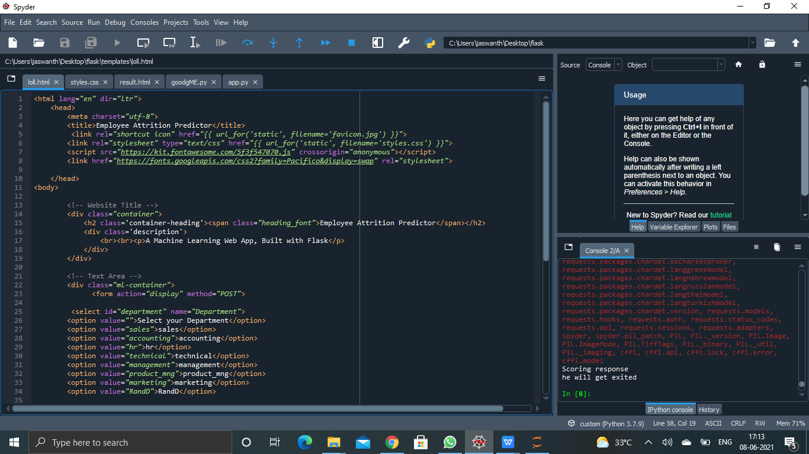
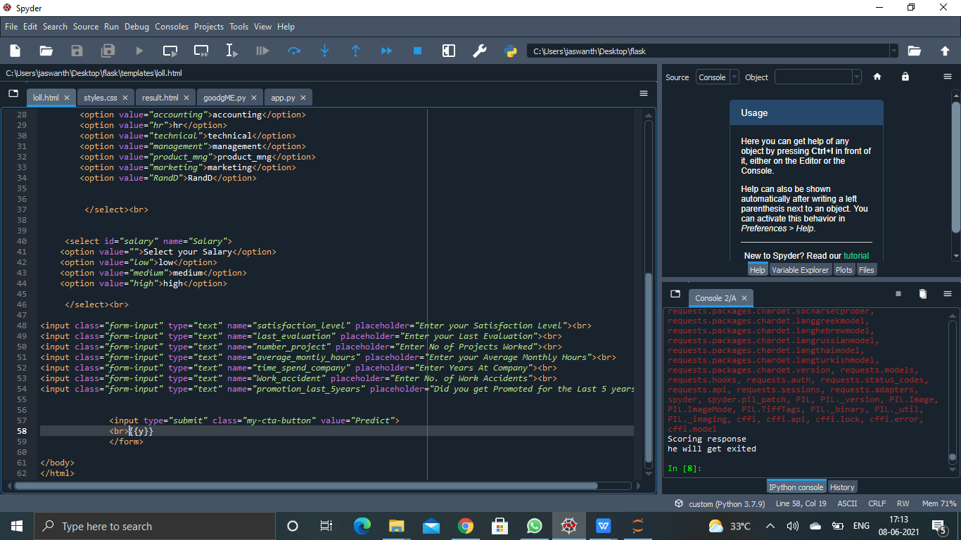

Slide 23
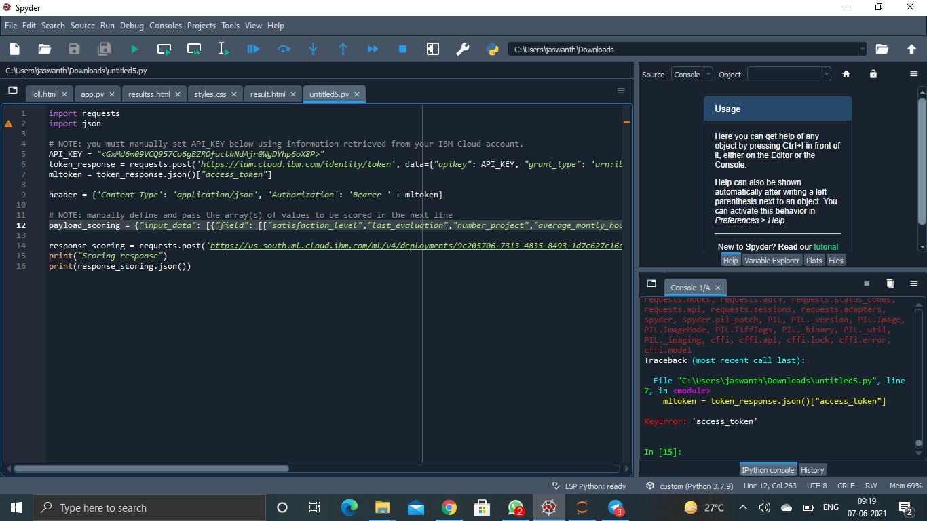
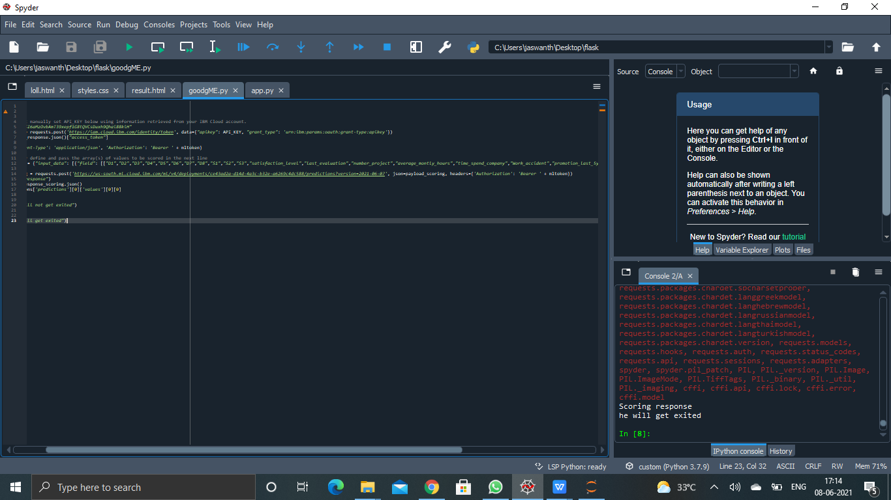
INPUT FROM IBM OUTPUT

Slide 24
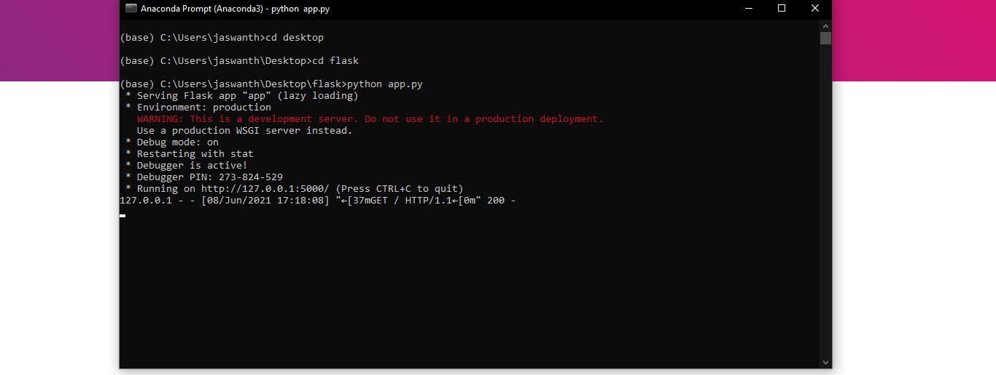
PROMPT FOR OPENING FILE

Slide 25
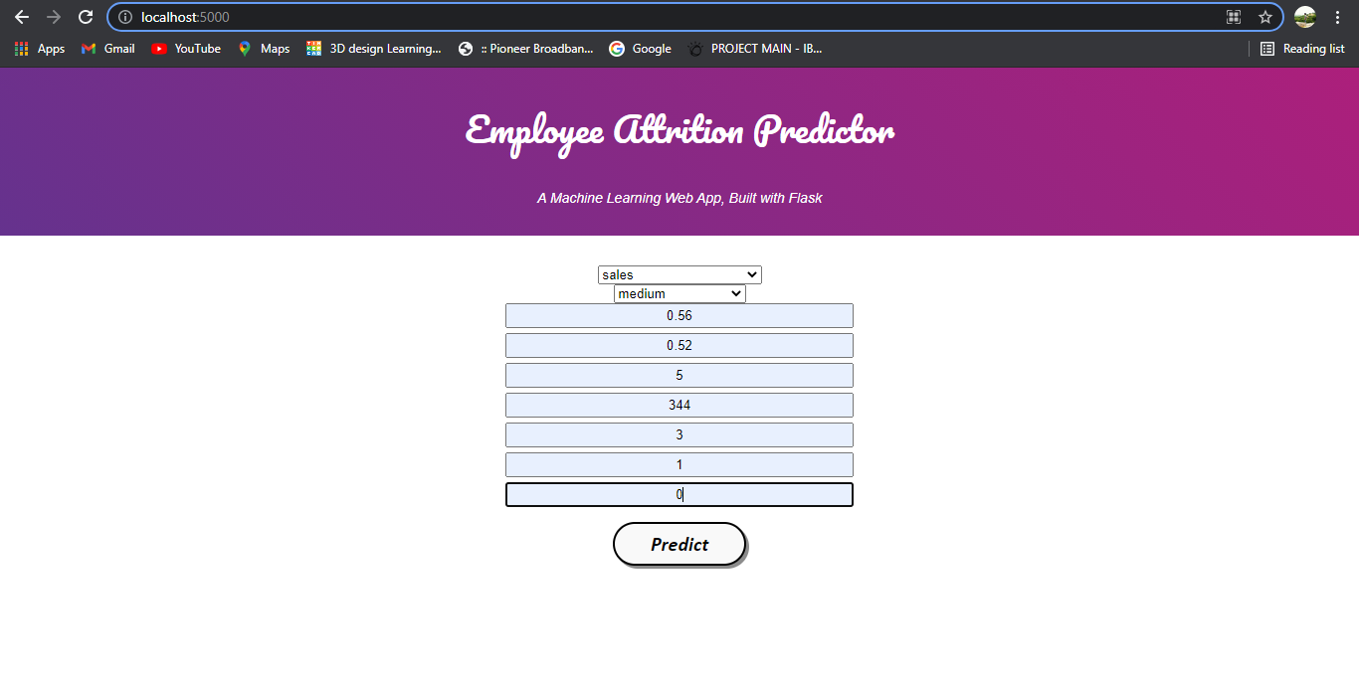
INPUT

Slide 26
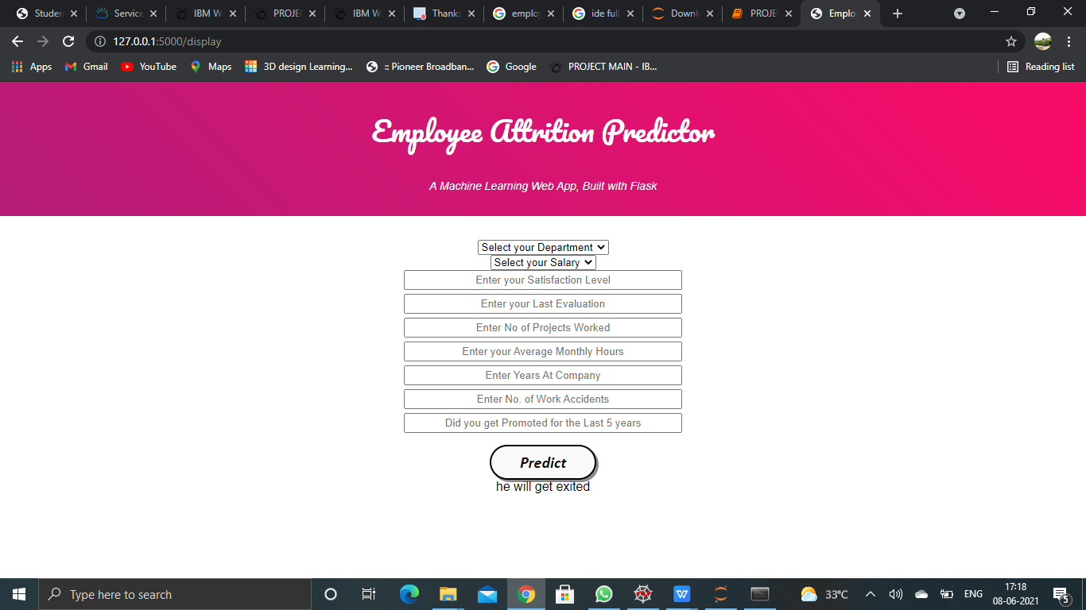
OUTPUT

Slide 27


